Slide 1

Global Flight Operation
Connecting the World
Effective 1st of August 2024 | Global Air Freight

Slide 2

DB SCHENKER Flight Operation
Connecting the World
Integrated Supply Chain - DB SCHENKER´s flight operations are integrated into the global airfreight hub system. The utilization of our land transport networks allows Schenker control over the complete transport chain:
Independence from commercial airlines and their flight schedules
Reduction of transit time due to fast and easy pre-/ on carriage through our Trucking Networks
Stable uplift and capacity in an unpredictable market situation
Wide range of shipping solutions for heavy and oversized, including hazardous goods
Availability of capacity even during peak seasons
Lean production due to the reduction of intermediates in the transport chain
DB SCHENKER | Global Air Freight | eff. 1st of August 2024

Slide 3
DB SCHENKER Global Flight Network 2024
Visual Flight Schedule
FRA / LUX
ORD
ICN
CGO
PVG
HKG
These scheduled charter flights are in addition to other major commercial block space agreements DB Schenker holds with preferred airline partners.

Slide 4

DB SCHENKER Flight Operation
Visual Flight Schedule
These increased scheduled charter flights are in addition to other major commercial block space agreements DB Schenker holds with preferred airline partners.
1
2
3
4
5
6
7
* DEP/ARR in UTC
* All schedules subject to change
ORD-ICN-PVG-ORD
B747-400F
Start of roundtrip day 6 (ORD)
ORD-ICN-PVG-ORD
B747-400F
Start of roundtrip day 4 (ORD)
FRA-CGO-LUX
B777F
Start of roundtrip day 2 (FRA)
PVG-FRA
B777F
PVG-ORD
B747-400F
HKG-ORD
B777F

Slide 5
Flight Ops „one pager“ on next slide

Slide 6
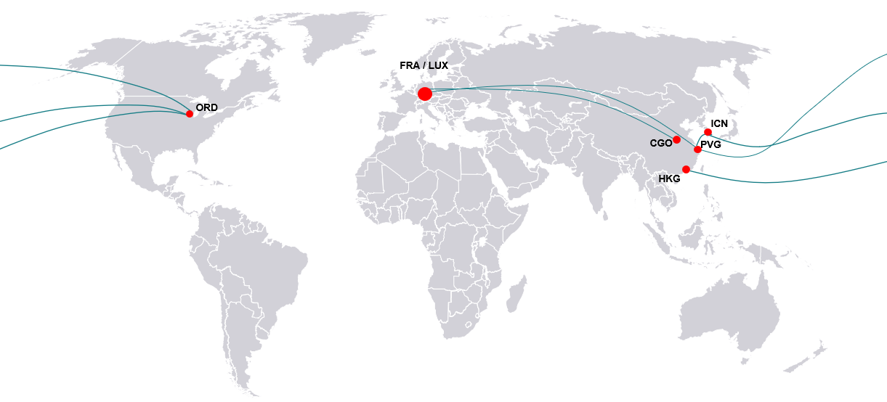
DB Schenker Global Flight Network 2024
Get fast, reliable air cargo service to/from key market gateways
DB Schenker Global Flight Network
Operational per August 2024
Chicago (ORD) – Seoul (ICN) – Shanghai (PVG) – Chicago (ORD)
Frankfurt (FRA) – Zhengzhou (CGO) – Luxembourg (LUX)
Hongkong (HKG) – Chicago (ORD)
Shanghai (PVG) – Frankfurt (FRA)
Shanghai (PVG) – Chicago (ORD)
These scheduled charter flights are in addition to other major commercial block space agreements DB Schenker holds with preferred airline partners.

